Slide 1

Teaching material for a course in Software Project Management & Software Engineering – Part I

Slide 2
Chapter 1
In this chapter, we will learn
What is a project?
What is a software project?
What processes are involved in a software project?
How are people, processes, tools, and technology integrated in a project?
What are the characteristics of a good project manager?
What are the subprocesses in the area of project management processes?
What management metrics are measured in software projects?

Slide 3
Part 1: Project Management
Chapter 1 (Introduction)
Any set of activities can be considered to be a Project if they have a definite start time and end time and these set of activities achieve some pre defined goals.
A project needs resources for a definite period of time. These resources are released after project gets completed.

Slide 4
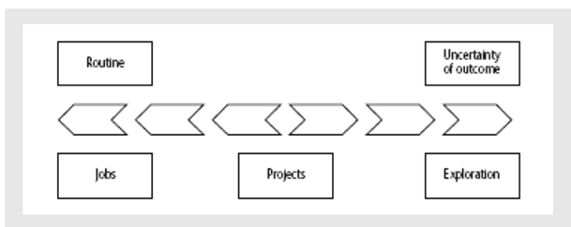
Jobs versus projects
versus projects
‘Jobs’ – repetition of very well-defined and well understood tasks with very little uncertainty
‘Exploration’ – e.g. finding a cure for cancer: the outcome is very uncertain
‘Projects’ – in the middle!

Slide 5
Are software projects really different from other projects?
Not really! …but…
Invisibility
Complexity
Conformity
Flexibility
make software more problematic to build than other engineered artefacts.
Notes:
This is based on Fred Brooks’ paper No Silver Bullet: Essence and Accidents of Software Engineering which appeared in IEEE Computer 20(4) pp10-19 April 1987

Slide 6
Characteristics of projects
A task is more ‘project-like’ if it is:
Non-routine
Planned
Aiming at a specific target
Work carried out for a customer
Involving several specialisms
Made up of several different phases
Constrained by time and resources
Large and/or complex
Notes:
Exercise 1.1 in the Software Project Management text is a good way of introducing this material if you have time. I have found this exercise to be a good ‘ice-breaker’. Get each student to list the example activities in an order which matches the degree to which they merit the description of ‘project’. You can create a grid on a whiteboard with the projects on the vertical axis and the positions 1st, 2nd, 3rd etc on the horizontal axis. You then go through asking how many put ‘producing a newspaper’ first, second, etc. (Avoid making jokes about this being like the Eurovision song contest). This is time-consuming but it does mean that every student participates in building up a general picture of people’s perceptions, and you can discuss disagreements in perceptions as you go along.

Slide 7
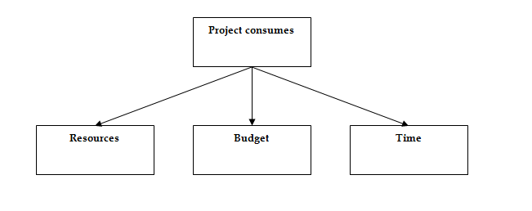
Part 1: Project Management Fundamentals
Chapter 1 (Project Management Introduction)
Project consumes resources, time and budget

Slide 8
Part 1: Project Management
Chapter 1 (Introduction)
A project can be initiated to build a road, a building, a software product etc. Managing a project will need different kinds of metrics, tools, skills etc.
A project can be broken down into project phases. These project phases include project initiation, project planning, project monitoring & control and project closure.
For each kind of project, there could be sub processes within each of the project phases. These sub processes are not related to project processes but belong to industry specific processes. For example, software development lifecycle processes (requirement gathering, software design etc.) fall within various project processes but are not part of project processes.
Software project management is the management of any software project. Specialized skills are needed to manage these projects for example software engineering, software testing, software design etc.

Slide 9
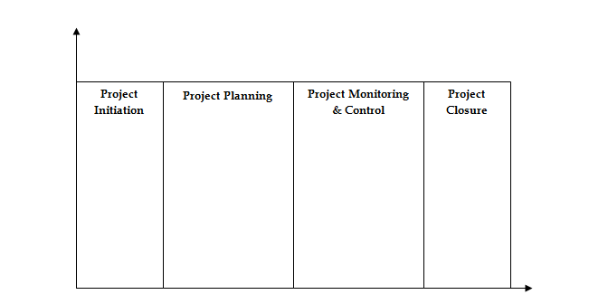
Part 1: Project Management Fundamentals
Chapter 1 (Project Management Introduction)
Project phases

Slide 10
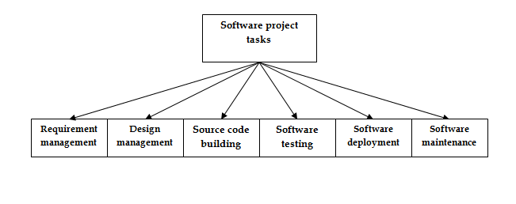
Part 1: Project Management Fundamentals
Chapter 1 (Project Management Introduction)
Software tasks in software projects

Slide 11
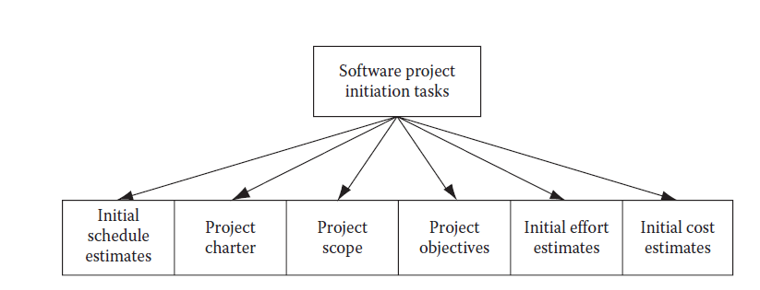
Part 1: Project Management Fundamentals
Chapter 1 (Project Management Introduction)
Project initiation tasks

Slide 12
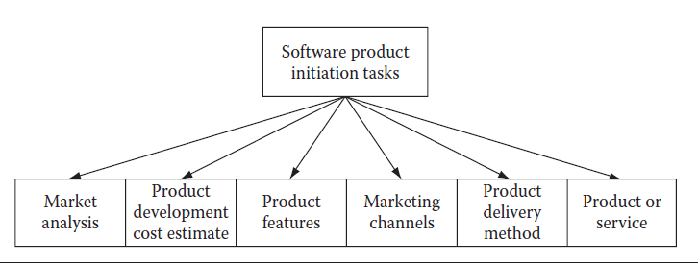
Part 1: Project Management Fundamentals
Chapter 1 (Project Management Introduction)
Software product development initiation tasks

Slide 13
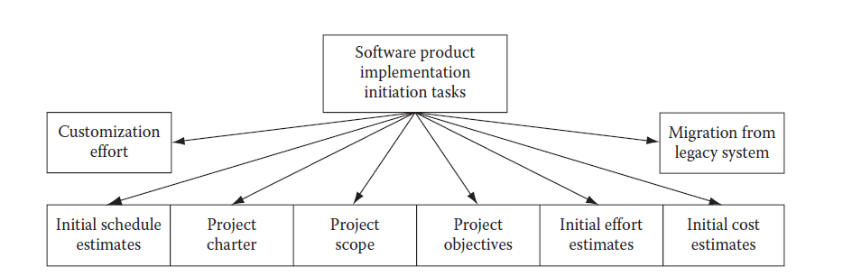
Part 1: Project Management Fundamentals
Chapter 1 (Project Management Introduction)
Software product implementation initiation tasks

Slide 14
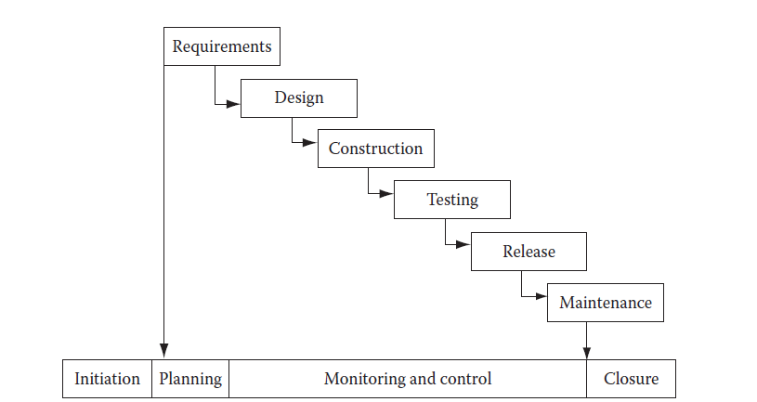
Part 1: Project Management Fundamentals
Chapter 1 (Project Management Introduction)
Project management in waterfall model environment

Slide 15
Part 1: Project Management Fundamentals
Chapter 1 (Introduction)
A software project will have processes like software life cycle processes (requirement gathering, software design, software construction, software testing etc.), software project processes, software configuration management

Slide 16
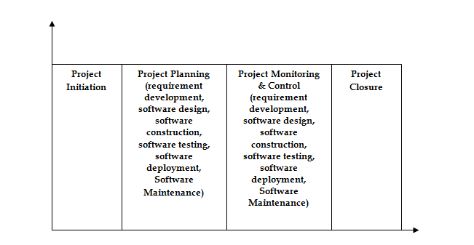
Part 1: Project Management Fundamentals
Chapter 1 (Project Management Introduction)
project phases with software lifecycle tasks

Slide 17
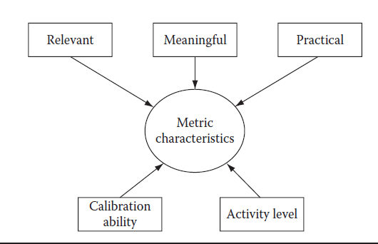
Part 1: Project Management Fundamentals
Chapter 1 (Project Management Introduction)
Quality Characteristics required of software project metrics

